Slide 1
Android TimeSheet
Pavan Ganesh

Slide 2
AnDroid TimeSheet
TimeSheet android application helps the user to log their effort without forgeting as old process you need to login to your SDP portal to log.
Here we have SDP portal built into an App, which you start log timer at the start of the day and end the timer at the day which will be sent back to the SDP server.
You can also pause the time whenever you want, and resume it back

Slide 3
Scenarios
Timer should run in background
User can pause whenever user request's
If timer is running when day is completed, it should save log of that day, and restart the timer
On logout also when timer is running it should save the log

Slide 4
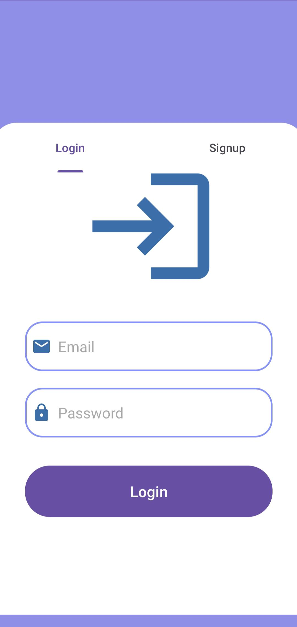
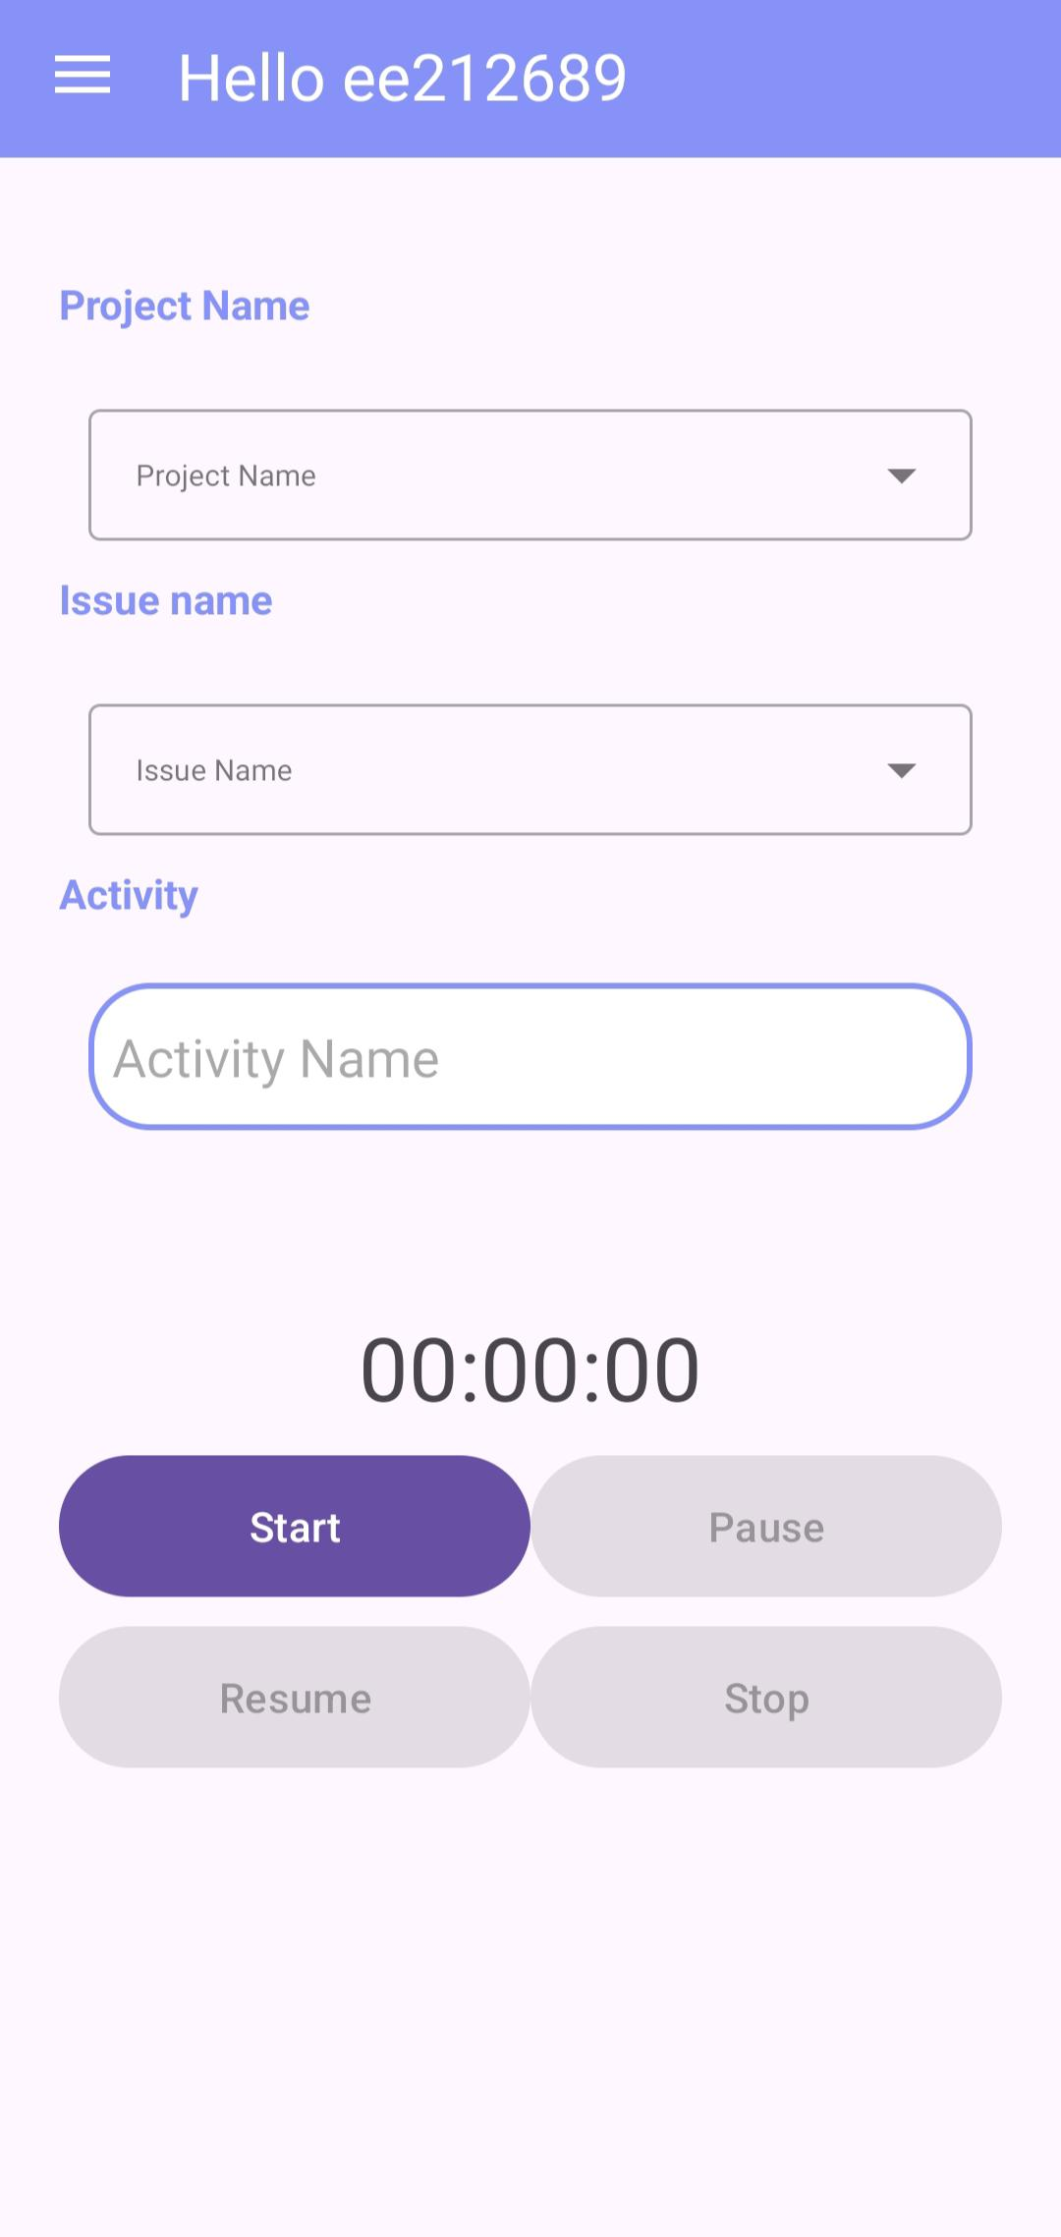
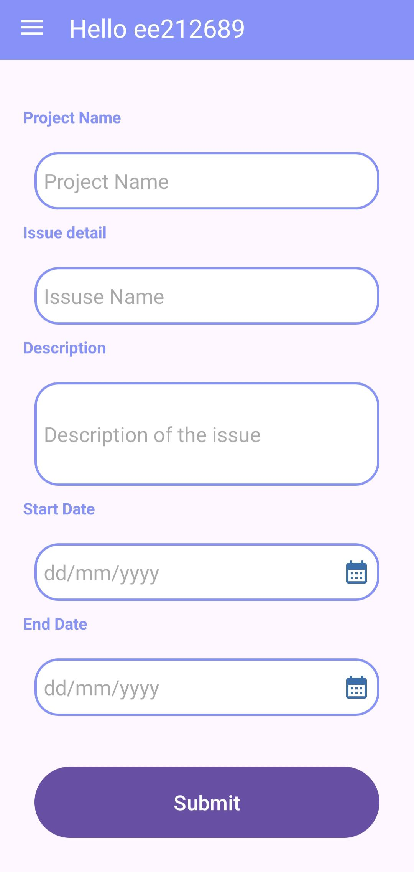
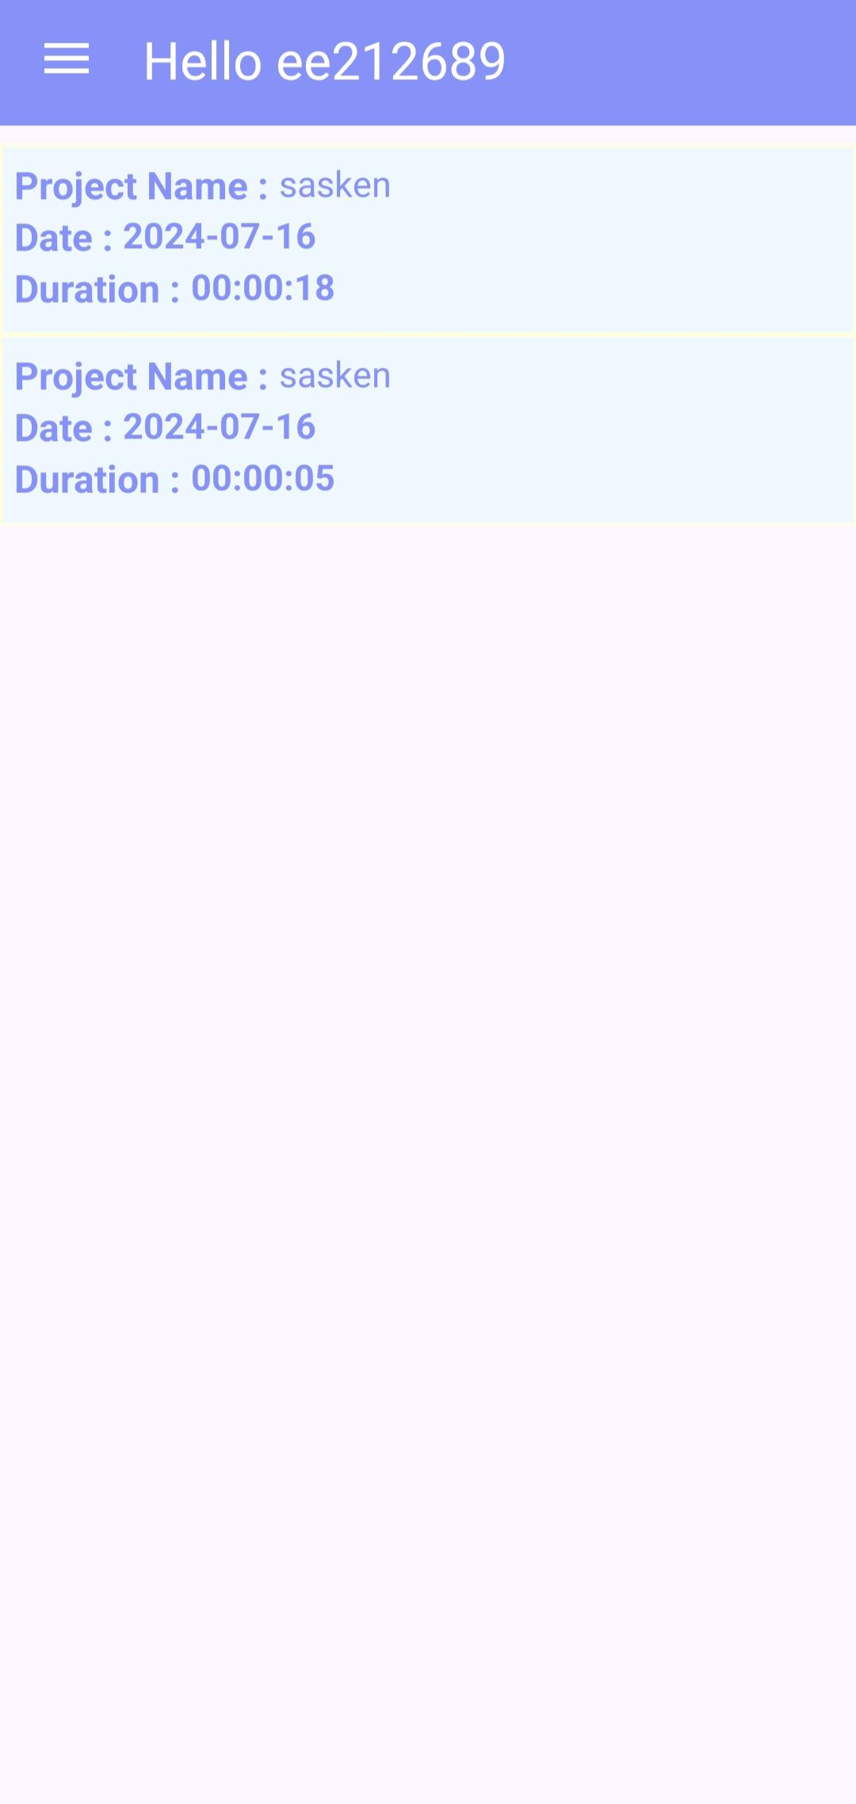
User Screens
Login Screen
Home Screen
Add Issue
Log Efforts

Slide 5
Test cases covered
User Validation and Authentication
Locking the dropdown list on click of start button
Disabled the stop button if timer activity is not started
Checking the timer changed when date change occurs while timer is running
Checking if the user is present already
On logout the data is cleared or not
Checking if empty timer is added to Database

Slide 6
Topics
Activity lifecycle, Fragments, Intent, Intent filter, Services.
Broadcast, Handler and Looper, Layouts, Shared Preferences.
Database (Room), Basics of Android Abstraction (Components).

Slide 7
Thank you

